Slide 1
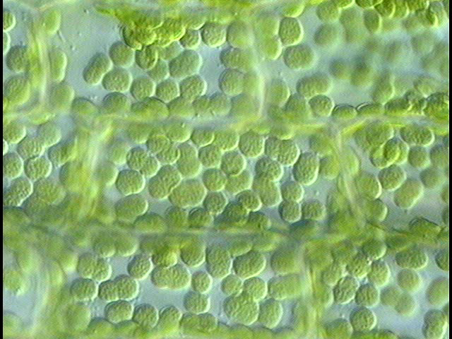

Slide 2
…and yet they move.

Slide 3
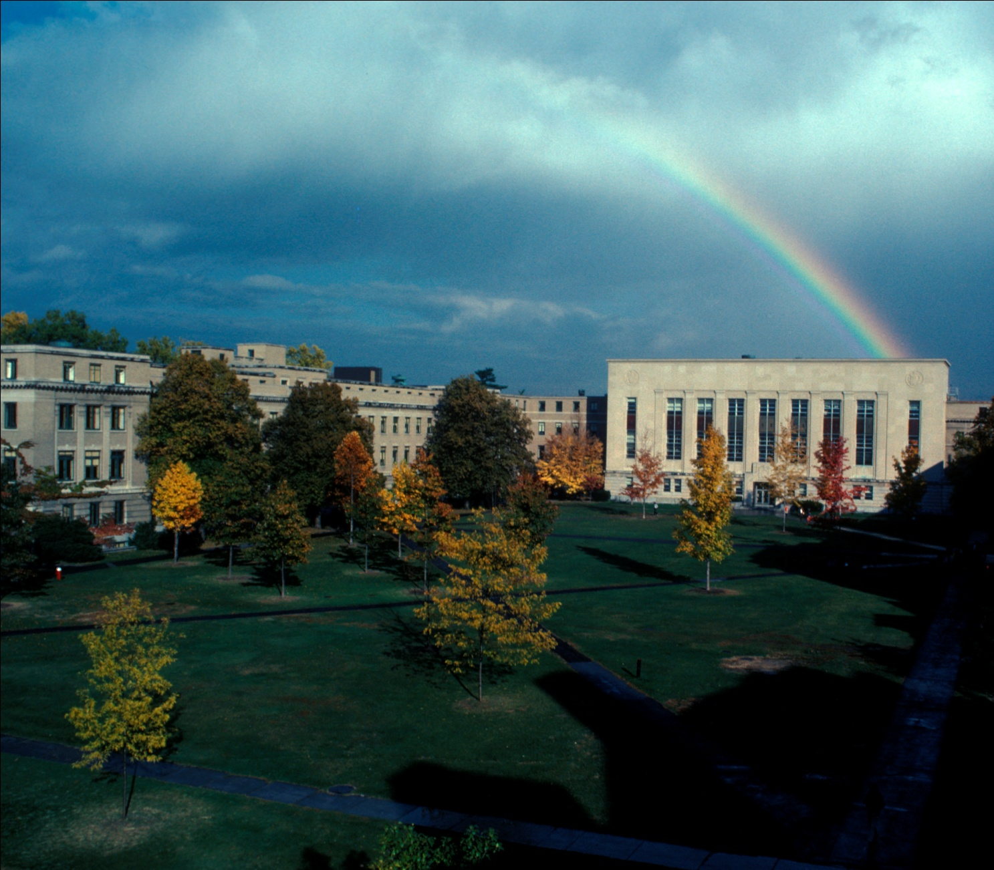
Thank You to Cornell Library

Slide 4
Thank You to Cornell Library
141 Pages of References

Slide 5
Thank You to Cornell Library
141 Pages of References
Online and Searchable

Slide 6
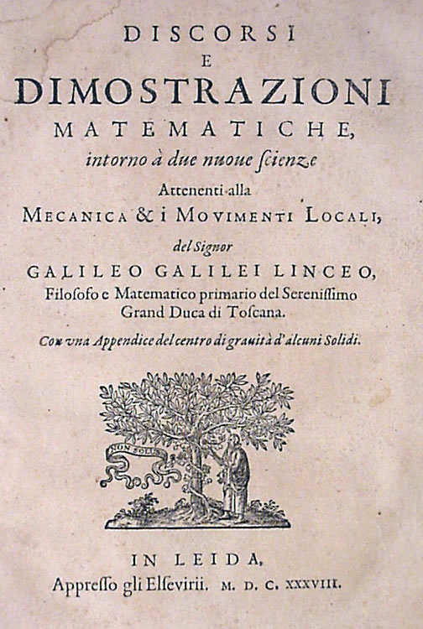

Thank You to The House of Elzevir
In 1638, Louis Elzevir published a book by Galileo, whose unfashionable works had been suppressed by the Catholic Church.
To this day, Elsevier continues to publish unfashionable books.

Slide 7
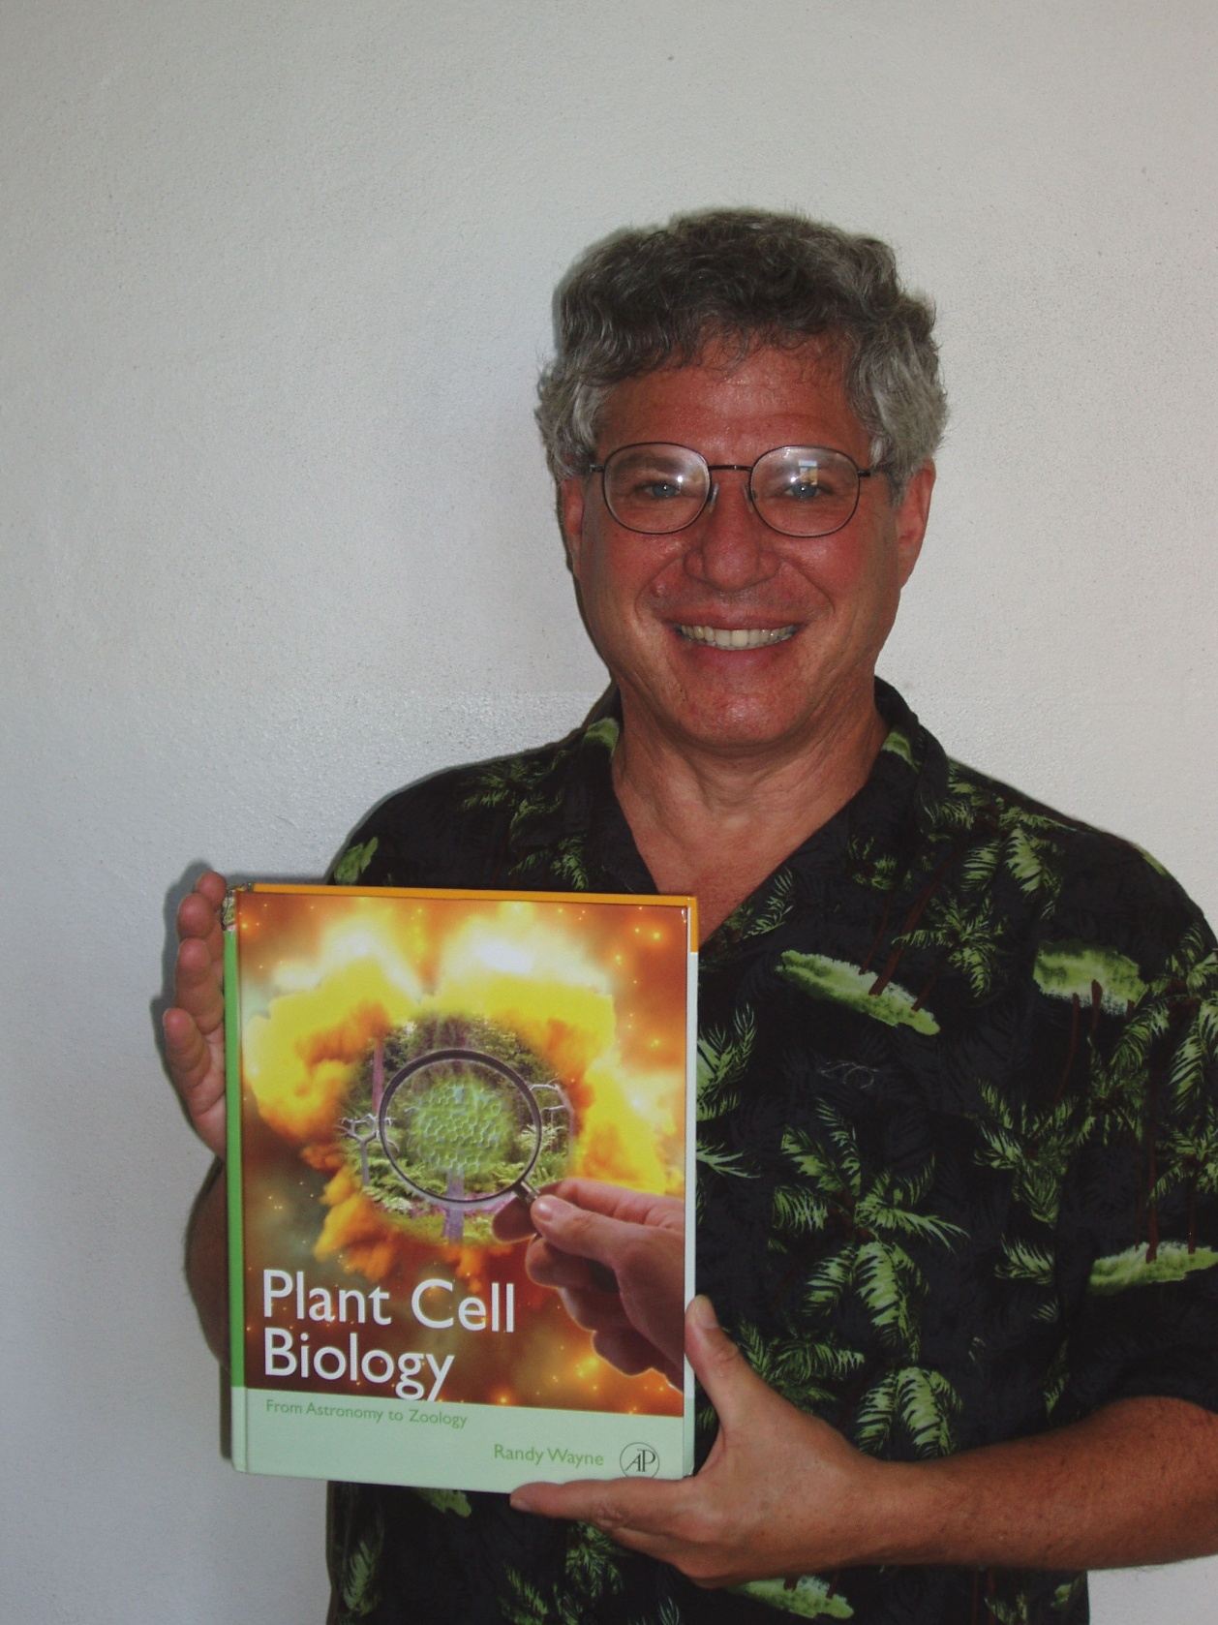

Slide 8
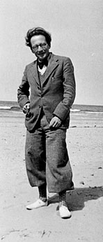
Erwin Schrodinger: The Value of Science
“You may ask—you are bound to ask me now: What, then, is in your opinion the value of natural science? I answer: Its scope, aim and value is the same as that of any other branch of human knowledge. Nay, none of them alone, only the union of all of them, has any scope or value at all, and that is simply enough described: it is the command of the Delphic deity…get to know yourself.”

Slide 9


Slide 10
“There is no real divisions
between disciplines.”

Slide 11
“There is no real divisions
between disciplines.”
“Centuries-long
collaborations
can happen.”

Slide 12
Fashion in 1952
In 1952, Edgar Bright Wilson Jr. wrote in An Introduction to Scientific Research, “…there is no excuse for doing a given job in an expensive way when it can be carried through equally effectively with less expenditure.”

Slide 13

The Current Fashion of Sell Buyology
Today, with an emphasis on research that can garner significant money for a college or university through indirect costs (F & A) and through patents and licenses, …there is no excuse for doing a given job in an inexpensive way when it can be carried through equally effectively with more expenditure.

Slide 14
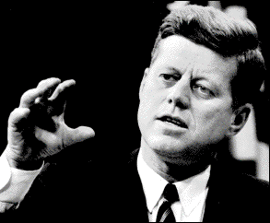
Dedicated to President John F. Kennedy for inspiring my generation to be courageous in the pursuit of science

Slide 15
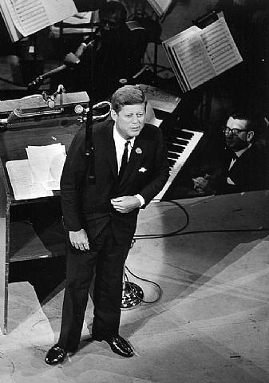
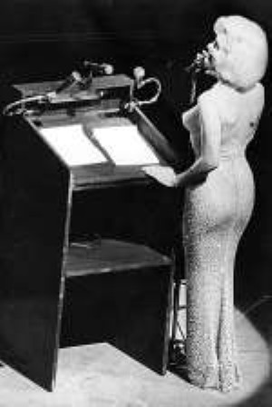

Slide 16
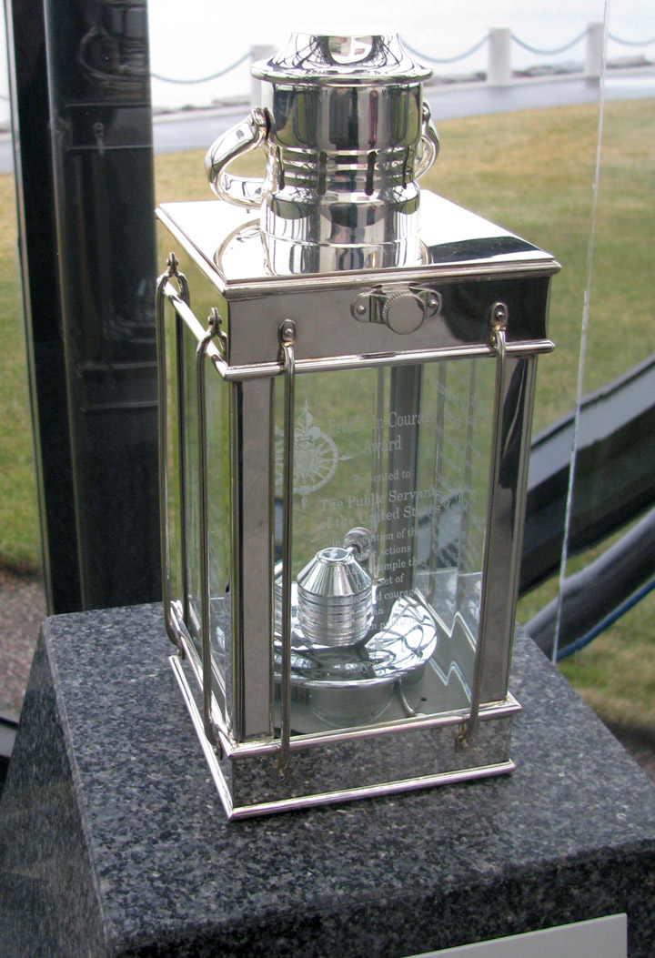
Profiles in Courage Award
In whatever arena of life one may meet the challenge of courage… each…must decide for himself the course he will follow….
—John F. Kennedy
Profiles in Courage

Slide 17
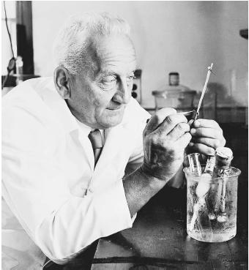
A Profile in Courage
Albert Szent-Gyorgyi, a biochemist who won the Nobel Prize for isolating vitamin C from Hungarian peppers, risked his life to help Hans Krebs and other Jews escape from Nazi Germany.
As a result of his anti-Nazi activities, Hitler personally instructed the Gestapo to capture Szent-Gyorgyi “so that the world will know how such a Schweinhund should be dealt with.”
Albert Szent-Gyorgyi
Hans Krebs

Slide 18

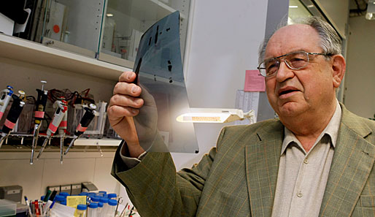
A Profile in Courage
Plant and animal cell biologist Werner Franke exposed illegal East German steroid research and the illegal doping of athletes.

Slide 19
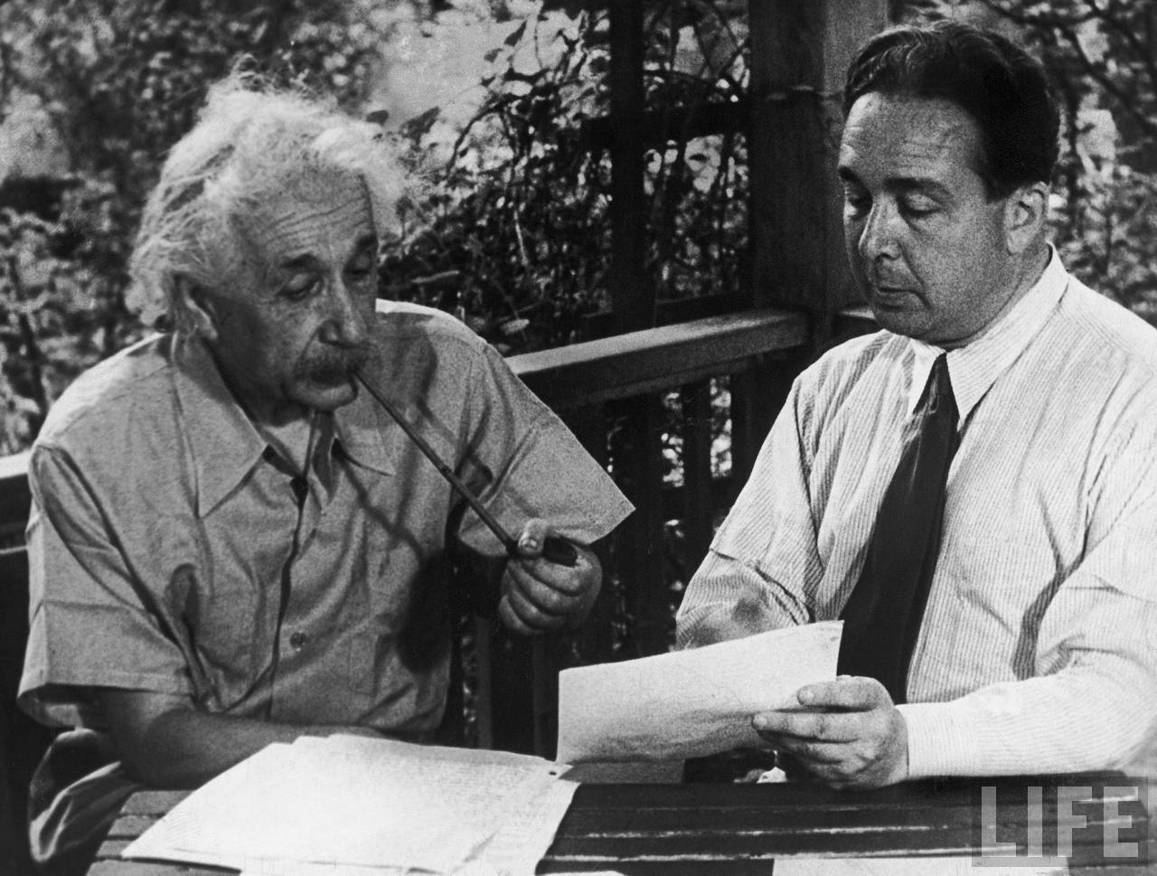
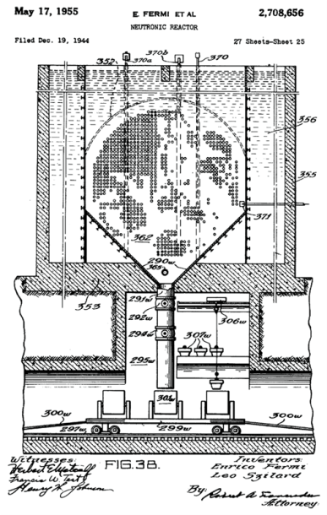
“I get my best ideas while taking a bath. But with biology I have problems; I always have to jump out and look up a fact.”
—Leo Szilard

Slide 20
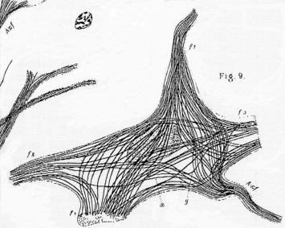
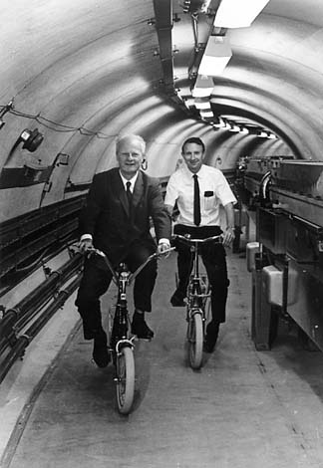
The Power of Numbers
Hans Bethe helped me understand how the power of numbers could be applied to cells. His father, Albrecht Bethe was a biologist who studied the cytoskeleton of neurons.

Slide 21
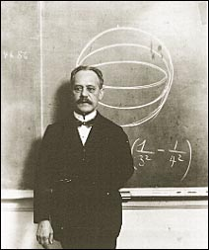
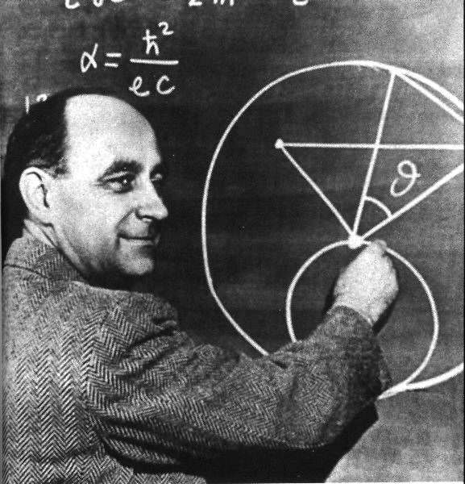
The Power of Numbers
Arnold Sommerfeld Enrico Fermi

Slide 22
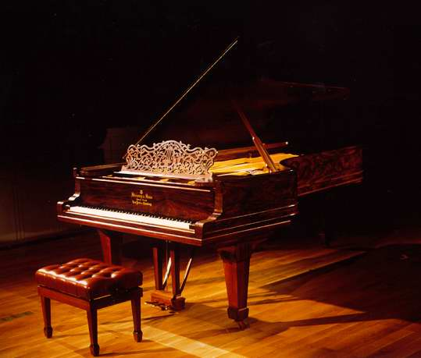
Many Piano Tuners are there in Los Angeles?

Slide 23

The Fermi Solution
If the problem seems like you have neither enough information nor the slightest chance to solve it…
Divide the problem into manageable pieces—with each piece being solvable from first principles obtainable from a reference, from an expert, or from performing a calculation or an experiment.

Slide 24
The Fermi Solution
How Many People in the City of Los Angeles? 3,000,000
What percentage has pianos?
How often does a piano need to be tuned?
How many pianos can a piano tuner tune in a day?
How many days a year does a piano tuner work?

Slide 25
The Fermi Solution
How Many People in the City of Los Angeles? 3,000,000
What percentage has pianos? 3%--there are 90,000 pianos in LA
How often does a piano need to be tuned?
How many pianos can a piano tuner tune in a day?
How many days a year does a piano tuner work?

Slide 26
The Fermi Solution
How Many People in the City of Los Angeles? 3,000,000
What percentage has pianos? 3%—there are 90,000 pianos in LA
How often does a piano need to be tuned?
Once a year—90,000 pianos have to be tuned each year
How many pianos can a piano tuner tune in a day?
How many days a year does a piano tuner work?

Slide 27
The Fermi Solution
How Many People in the City of Los Angeles? 3,000,000
What percentage has pianos? 3%—there are 90,000 pianos in LA
How often does a piano need to be tuned?
Once a year—90,000 pianos have to be tuned each year
How many pianos can a piano tuner tune in a day? 3—there has to be 30,000 days of tuning
How many days a year does a piano tuner work?

Slide 28
The Fermi Solution
How Many People in the City of Los Angeles? 3,000,000
What percentage has pianos? 3%—there are 90,000 pianos in LA
How often does a piano need to be tuned?
Once a year—90,000 pianos have to be tuned each year
How many pianos can a piano tuner tune in a day? 3—there has to be 30,000 days of tuning
How many days a year does a piano tuner work? 250—there are about 120 piano tuners in LA

Slide 29


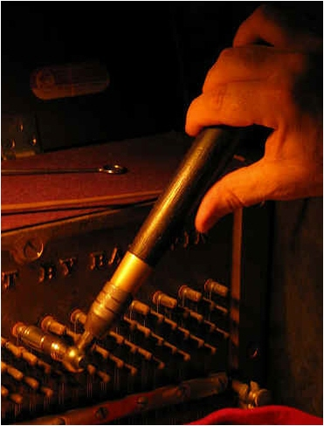

Of course you could always Google “piano tuners in Los Angeles”!
http://www.la-ptg.org/
http://www.pianoacoustics.com/states.htm

Slide 30

The Fermi Solution: Going from what you Know to what you do not Know by Asking the Right Questions

Slide 31
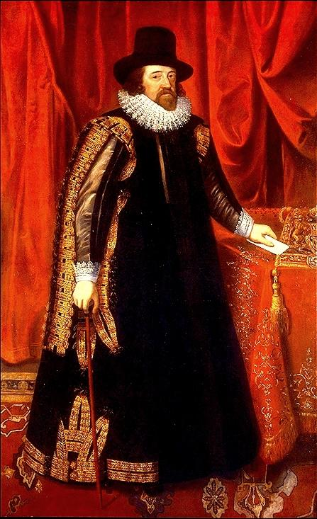
Francis Bacon: Define Terms Carefully
The Idols of the Marketplace
  "…there arises from a bad and unapt formation of words a wonderful obstruction to the mind….words manifestly force the understanding, throw everything into confusion, and lead mankind into vain and innumerable controversies and fallacies."
The Idols of the Tribe
The Idols of the Cave
The Idols of the Theatre

Slide 32
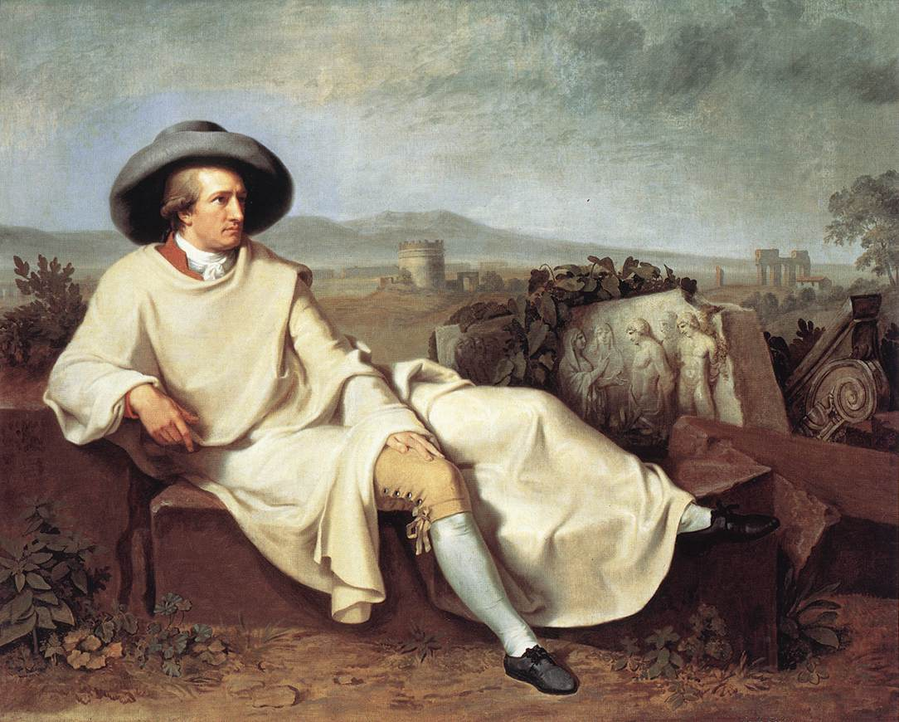
Goethe and the Power of Language
In Goethe’s (1808) Faust Part One, Mephistopheles says, “For at the point where concepts fail, At the right time a word is thrust in there. With words we fitly can our foes assail”.

Slide 33
Goethe and the Power of Language
A botanist →
In Goethe’s (1808) Faust Part One, Mephistopheles says, “For at the point where concepts fail, At the right time a word is thrust in there. With words we fitly can our foes assail”.

Slide 34
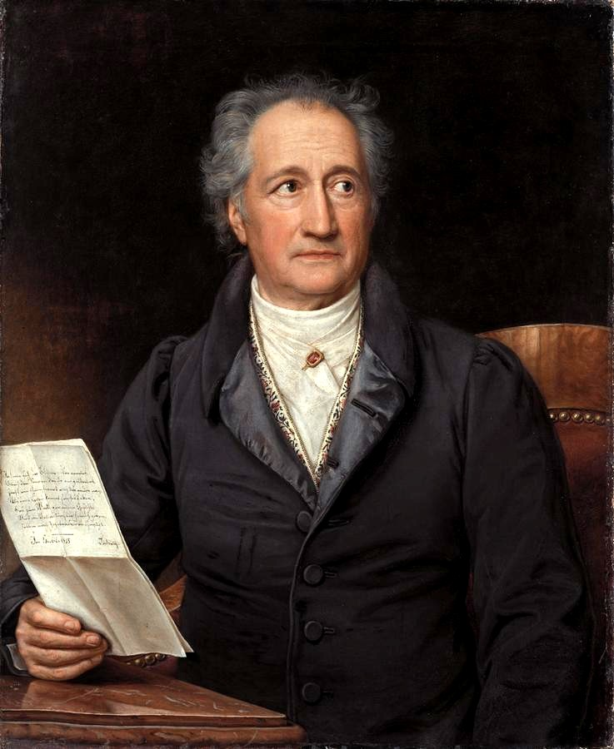
Thatige Skepsis
Johann Wolfgang Goethe

Slide 35
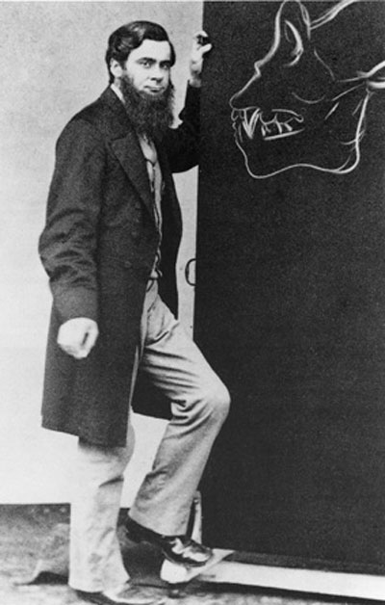
Thatige Skepsis
“An Active Skepticism is that which unceasingly strives to overcome itself and by well directed Research to attain to a kind of Conditional Certainty.”
Thomas H. Huxley

Slide 36
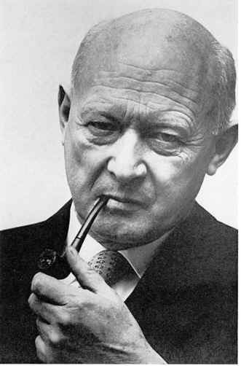
Questioning Authority
Nevertheless scientists have trouble in questioning the authority of the dominant group.
Conrad H. Waddington (1977) proposed in his book Tools for Thought, the acronym “COWDUNG” to signify the Conventional Wisdom of the Dominant Group.

Slide 37
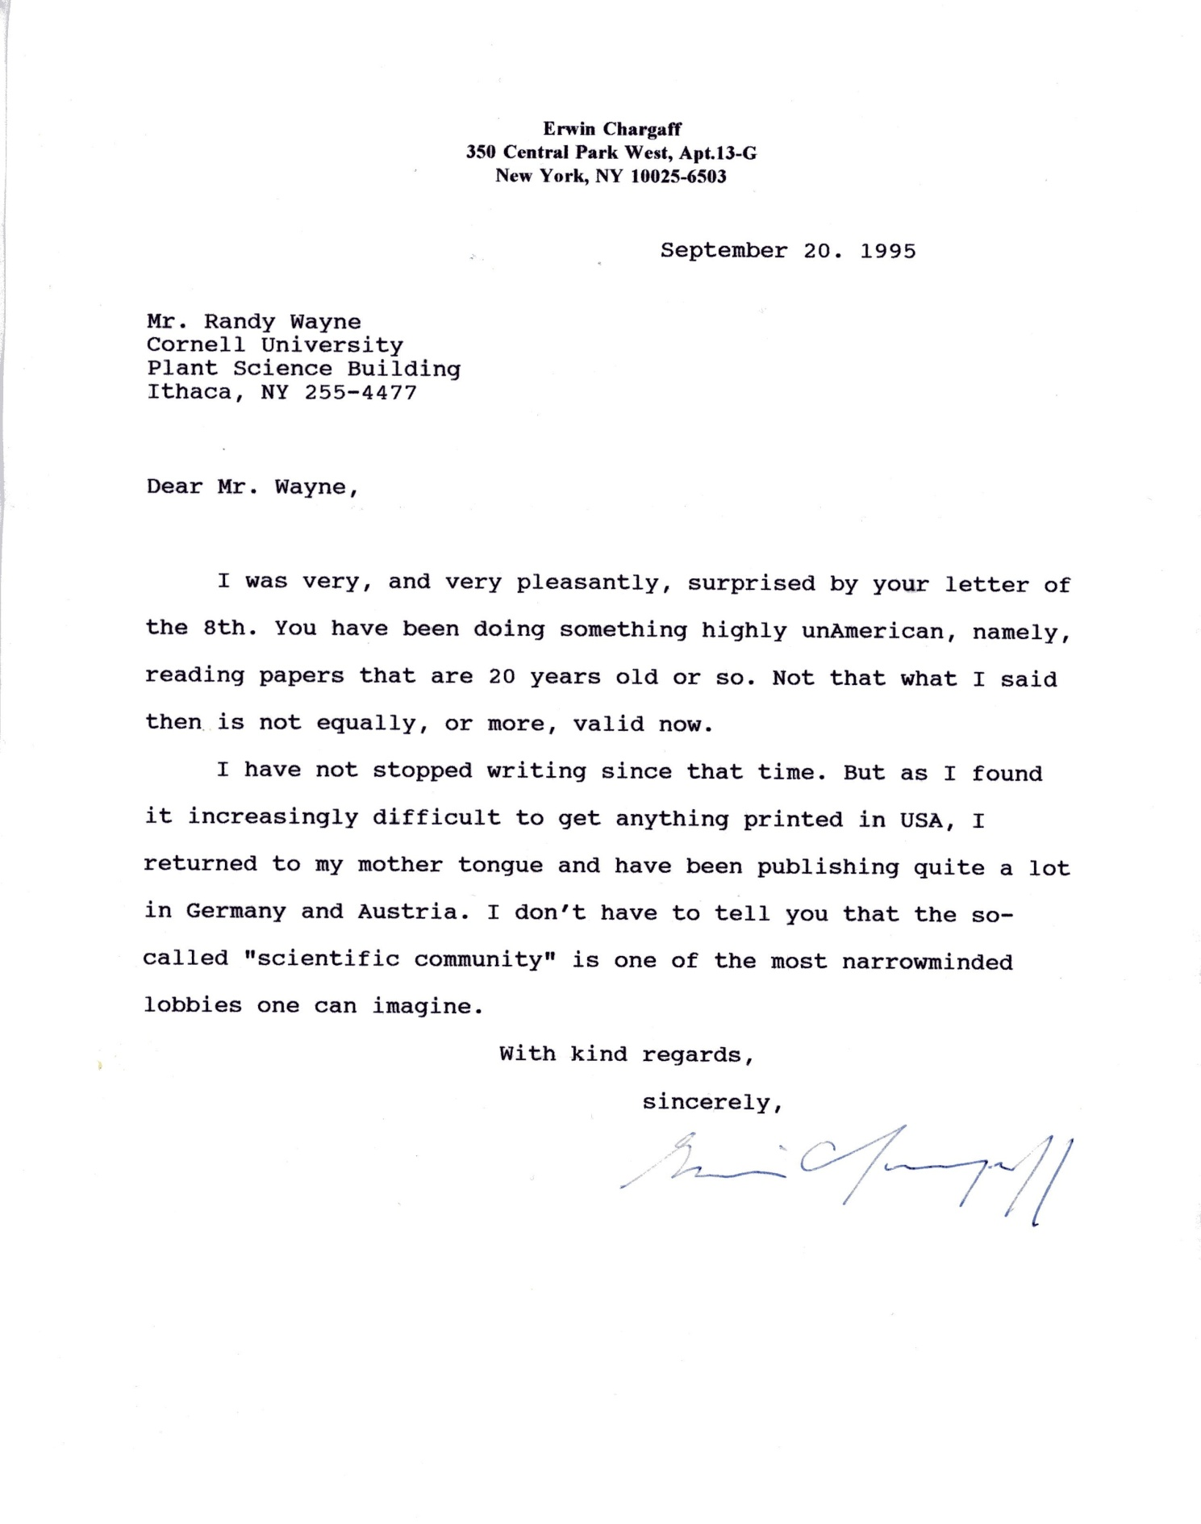
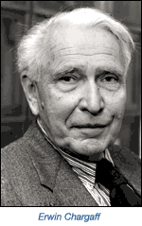

Slide 38
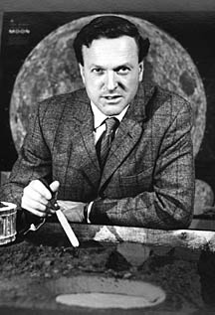
Skepticism
“New ideas in science are not always right just because they are new. Nor are the old ideas always wrong just because they are old. A critical attitude is clearly required of every scientist. But what is required is to be equally critical to the old ideas as to the new. Whenever the established ideas are accepted uncritically, but conflicting new evidence is brushed aside and not reported because it does not fit, then that particular science is in deep trouble—and it has happened quite often in the historical past.”
Thomas Gold

Slide 39
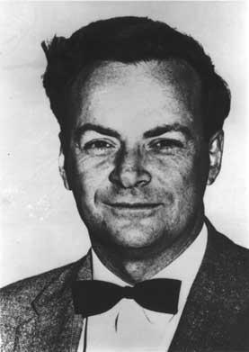
Skepticism
The greatest value of science is the freedom to doubt!
Richard Feynman

Slide 40

What is Life?
Sense the environment and respond appropriately.
Generate electricity.
Move as a result of forces generated within.
Take up nourishment from the environment.
Metabolize at ambient temperatures and pressures.
Reproduce with near-perfect fidelity.

Slide 41
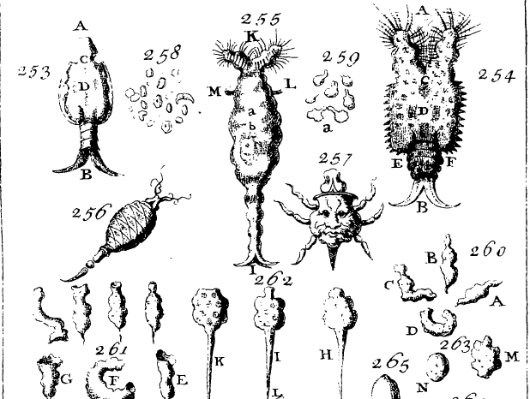
In the 17th and 18th century, microscopists, including Antony van Leeuwenhoek and George Adams, discovered animalcules or living atoms. By the 19th century, it became clear that these organisms could sense and respond appropriately to the environment.

Slide 42
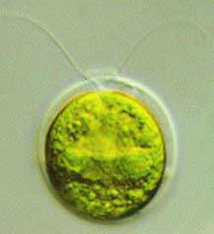
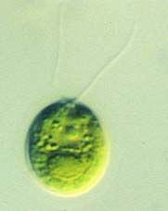
Chlamydomonas Step-Up Photophobic Response

Slide 43
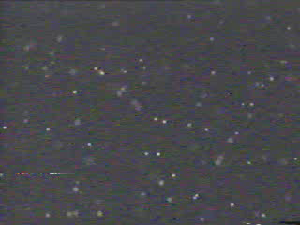
Step-Up Photophobic Response Initiated by a 10 μs Flash of Green Light

Slide 44
The Ability to Swim Backwards in Response to Light Requires Calcium
10⁻⁸ 10⁻⁶ 10⁻⁴ M Ca²⁺

Slide 45
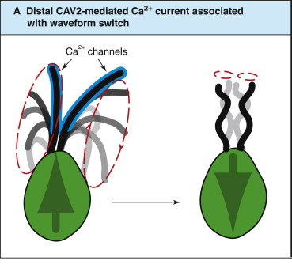

Slide 46
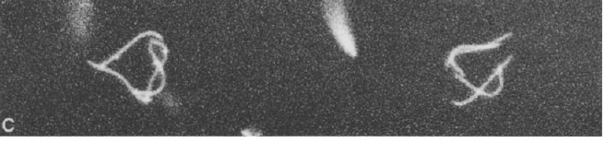
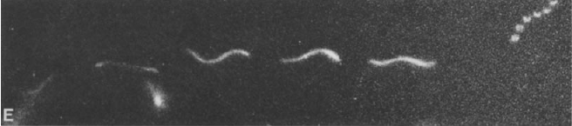
Low calcium
High calcium

Slide 47
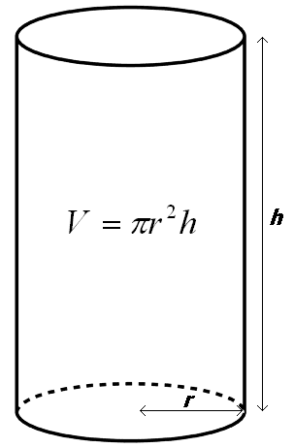
Step-Up Photophobic Response
(Change from Ciliary to Flagellar Beat)
Step-up photophobic response requires an increase in the ciliary Ca²⁺ concentration from 0.1 μM to 1 μM within 0.5 s.
How many Ca²⁺ ions have to enter the cilium in order for the Ca²⁺ concentration to rise from 0.1 μM to 1 μM?
The cilium can be modeled as a cylinder 15 μm long and 250 nm in diameter.

Slide 48
How many Calcium Ions are Needed to Change from a Ciliary to a Flagellar Beat?
The volume of the cilium is 7.4 x 10⁻¹⁹ m³.
0.1 μM = 10⁻⁴ mol/m³
(10⁻⁴ mol/m³)(7.4 x 10⁻¹⁹ m³) (6.02 x 10²³ Ca²⁺/mol) = 44 Ca²⁺
1 μM = 10⁻³ mol/m³ = 443 Ca²⁺
The entry of 399 Ca²⁺ into the cilium causes the change from ciliary to flagellar beat.

Slide 49
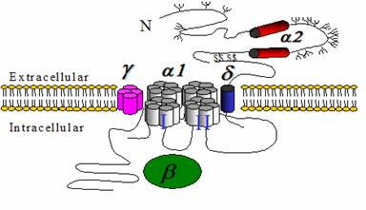
How many Ca²⁺ channels are needed to pass the 399 Ca²⁺ within 0.5 s?
A Ca²⁺ channel passes 10⁶ Ca²⁺/s.
Only one channel needs to be activated to change from a ciliary to a flagellar beat.

Slide 50
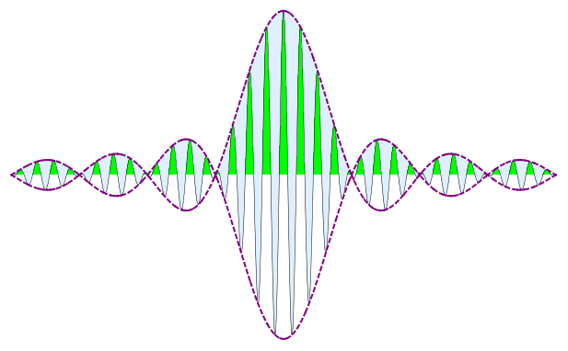
How many photons are needed to activate a Ca²⁺ channel?
A single channel requires about 10⁻¹⁹ J to become activated.
A photon of 510 nm light has 3.9 x 10⁻¹⁹ J of energy (E = hc/λ).
It may only take one photon absorbed by channelrhodopsin to change from a ciliary to a flagellar beat.

Slide 51
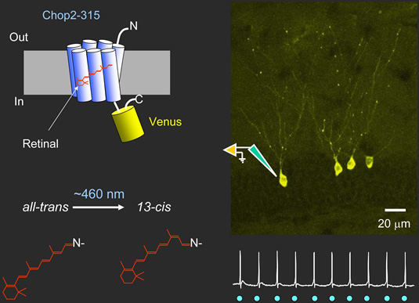
Karl Deisseroth (2007) can Transform Neurons with Channelrhodopsin

Slide 52
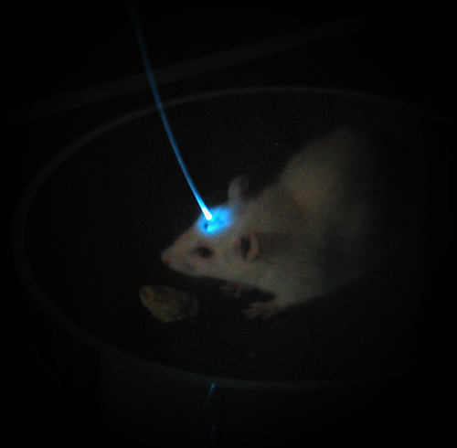

Slide 53
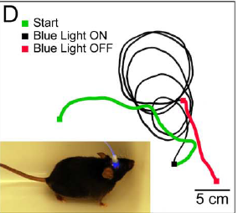

Slide 54
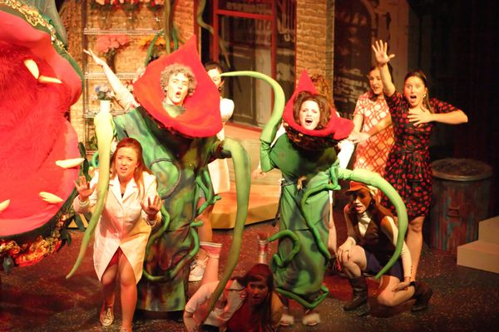
The Living World is But Mankind in the Making
Raoul Francé (1905) wrote, “What grander lesson could the speechless plants give than that which they have taught us: that their sense life is a primitive form, the beginning of the human mind... it tells us that after all the living world is but mankind in the making, and that we are but a part of all.”

Slide 55
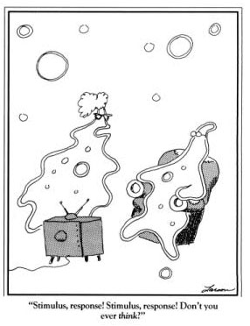
Free Will
I am a reductionist and believe that there is a causal chain consistent with the laws of thermodynamics that leads from the stimulus to the response. I also believe in free will.
Can a belief in the causal chain be consistent with the existence of free will in the sense that we can determine our own thoughts and actions?

Slide 56
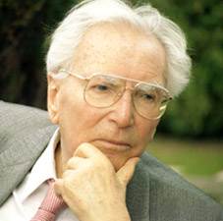
Free Will
“Between stimulus and response there is a space. In that space is our power to choose our response. In our response lies our growth and our freedom.”
Viktor Frankl

Slide 57
Free Will
“The very serious and difficult question arises of whether…free will is compatible with our scientific knowledge, which plainly says that the concept of a breach in causal continuity is not acceptable. From the point of view of science, the reality of free will cannot be conceded. On the other hand, as human beings, we depend on the belief that…our actions are preceded by deliberation and choice….”
Hans Mohr

Slide 58
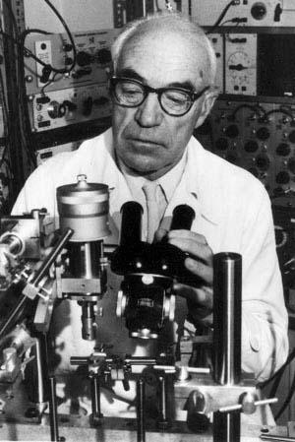
Free Will
“All I have to say is that free will is a fact of experience….Free will is often denied on the grounds that you can’t explain it, that it involved happenings inexplicable by present-day physics and physiology. To that I reply that our inability may stem from the fact that physics and physiology are still not adequately developed.…”
John Eccles

Slide 59
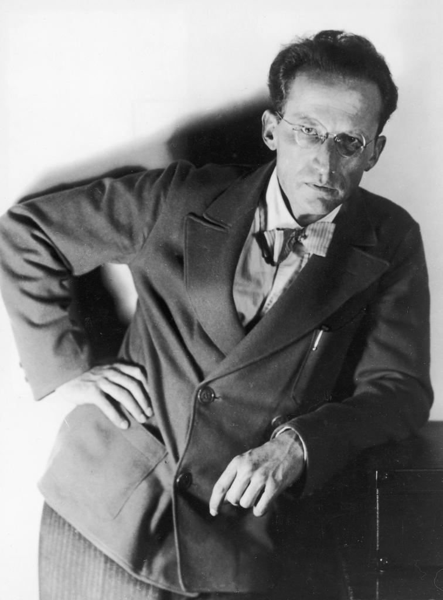
Erwin Schrodinger, the Son of a Botanist
“Living matter, while not eluding the laws of physics as established to date, is likely to involve other laws of physics hitherto unknown which, however, once they have been revealed, will form as integral a part of this science as the former.”

Slide 60
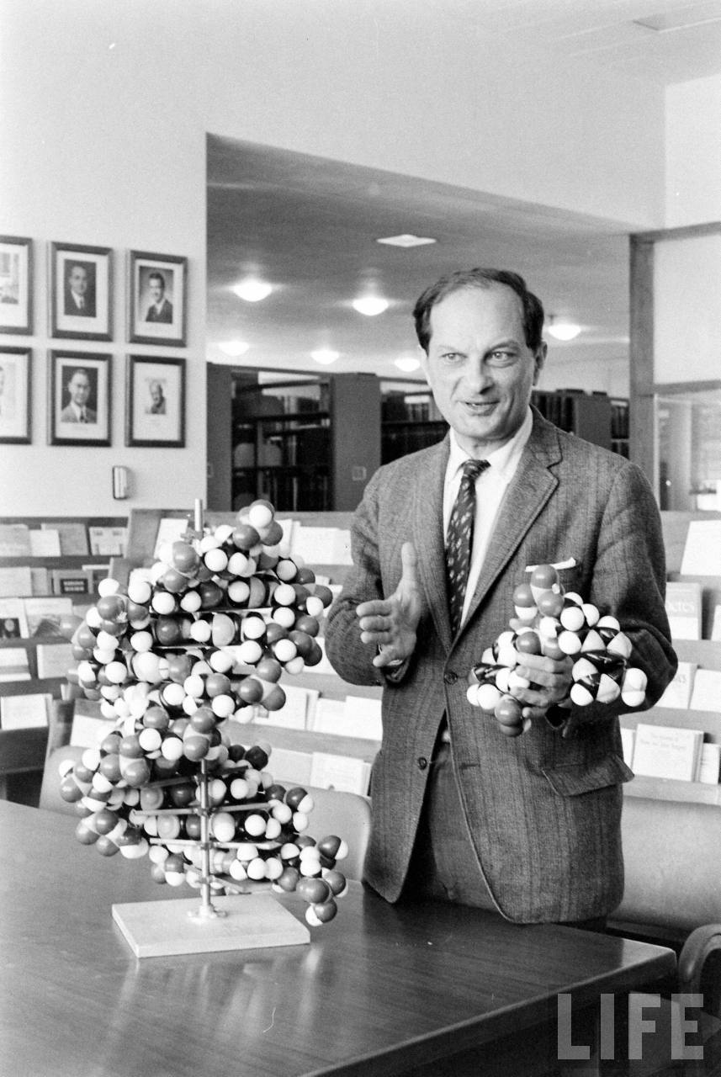
Stanislaw Ulam, Mathematician
“Ask not what physics can do for biology; but what biology can do for physics.”

Slide 61
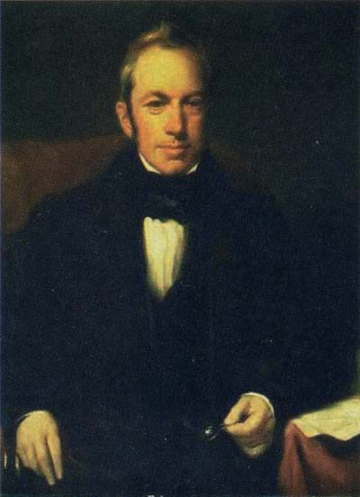
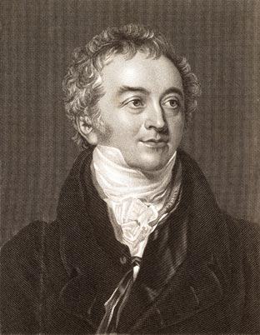
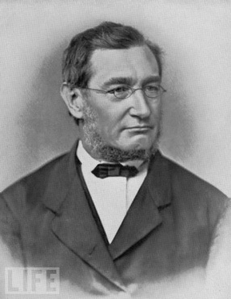


Physical Principles Discovered by Studying Life
Robert Brown: Study of pollination led to the discovery of Brownian Motion
Thomas Young: Study of vision led to Wave Theory of Light
J. Robert Mayer: Study of blood color led to the First Law of Thermodynamics
Jean Poiseuille: Study of blood flow led to the Law of Fluid Flow
Adolf Fick: Study of kidney function led to Laws of Diffusion

Slide 62


Avogadro’s Number—Biology, Chemistry or Physics?
Robert Brown (1828), a botanist studying pollen and pollination in Clarkia, found that the particles from within the burst pollen moved incessantly in water. At first he thought he found the vis viva, the living force…

Slide 63
Avogadro’s Number—Biology, Chemistry or Physics?
…then he realized that nonliving things, including dust from the Great Sphinx and other rocks of all ages, also moved incessantly, and movement was a property of molecules.

Slide 64


Avogadro’s Number
Hoping to convince the positivists like Ernst Mach that atoms and molecules really existed, Albert Einstein (1905) mathematically modeled the effect of molecular water on Brownian motion.
x = √(RTdt/3πrηN_{A})

Slide 65
Avogadro’s Number
If one were to measure the movement (mean-square displacement) of microscopic particles during a period of time, one could then calculate the number of molecules in a mole of substance (i.e. Avogadro’s Number).
N_{A} = (RT/3πrη)(dt/x²)

Slide 66


Avogadro’s Number (6.02 x 10²³/mol)
Jean Perrin (1909) determined Avogadro’s Number by looking at Brownian motion with a microscope and quantifying the movement with Einstein’s equation.

Slide 67



Avogadro’s Number:
A Century-Long Collaboration
Robert Brown Albert Einstein Jean Perrin

Slide 68



Avogadro (1776-1856) Never Knew Avogadro’s Number
1811

Slide 69


Slide 71


Robert Hooke’s Microscope

Slide 72


Robert Hooke (1665): Micrographia

Slide 73

.

Slide 74



The Cell is the Basic Unit of Life
Studies on macerated tissues
Developmental studies
Henri Dutrochet (1824)

Slide 75

Henri Dutrochet (1824) was
Ahead of his Time

Slide 76





Promoters of the Cell Theory (1838):
Matthias Schleiden and Theodor Schwann

Slide 77

Discovery of the Plasma Membrane
Karl von Nageli (1844) showed that plant cells shrank when placed in concentrated solutions and then returned to their original size when placed in dilute solutions.

Slide 78


Slide 79


Slide 80


Slide 81


Slide 82


Osmotic Movements in Plants
Wilhelm Pfeffer (1877)

Slide 83

Osmotic Movements in Plants
Wilhelm Pfeffer

Slide 84


Traube Cells
Traube Cells
Moritz Traube (1867)

Slide 85

Differential Permeability
To prevent the copper ferrocyanide membrane from breaking, Pfeffer precipitated it on a clay pot. It was then strong enough to experiment on its differential permeability in terms of water and sugar.
Since the membrane mimicked the properties of the living cell, Pfeffer concluded that the cell was surrounded by a plasma membrane and differential permeability was not a vital, but a physico-chemical process.

Slide 86


Slide 87


Slide 88


Hugo De Vries asked Jacobus Van’t Hoff to look at Pfeffer’s data. van’t Hoff recognized that Pfeffer’s data indicated that solutions obey the law of Avogadro and the gas laws (PV = nRT) and began the field of physical chemistry.

Slide 89


The Differentially Permeable Membrane of Plants Propagates an Action Potential
Nitella
Kacy Cole (1938)

Slide 90

The Differentially Permeable Membrane of Plants Propagates an Action Potential

Slide 91

Amber (ήλεκτρον = elektron )

Slide 92


The Unit Membrane
J. David Robertson (1959)

Slide 93


Fluid Mosaic Model
S. Jonathan Singer (1972)

Slide 94

One of the Proteins in the Plasma Membrane of Plants Cells Uses ATP to Produce Electricity
Roger Spanswick (1978)

Slide 95



Visualizing K⁺ Channels
Julian Schroeder (1987)
2 pA = 2 x 10⁻¹² C/s
(2 x 10⁻¹² C/s)/(1.6 x 10⁻¹⁹ K⁺/C = 1.25 x 10⁷ K⁺/s

Slide 96



A Century-Long Collaboration
“Though our understanding of the experimental results does not necessarily compel us to presuppose a very definite conception of the molecular structure…, we feel even more an intellectual need for deeper insight because only on the basis of such insight can our thoughts follow the path of solute through the membrane.”
—Wilhelm Pfeffer (1877)
Potassium channel visualized by Roderick MacKinnon (2004)
using the Cornell synchrotron.

Slide 97

Time and Space within a Cell:
Internal Membranes
Robert Hooke (1665) wrote, “…though I have with great diligence endeavored to find whether there be any such thing in those microscopical pores….some diligent observer, if helped with better microscopes, may in time, detect [them].”
Keith Porter was interested in using the newly developed electron microscope to see what was inside of cells.
Keith Porter (1945)

Slide 98

Chicken Embryo Fibroblast Cells (Porter et al., 1945)

Slide 99

Porter-Blum MT-1 Microtome

Slide 100

Paratoid Gland Cell (Palade and Porter, 1954)

Slide 101

Lettuce Root Cell (Hepler, 1981)

Slide 102


Slide 103


Another Century-Long Collaboration
George Palade (1964)

Slide 104


Slide 105


Movement of Proteins Through Cell
5 min
20 min

Slide 106

Movement of Proteins Through Cell
4 hr

Slide 107


Northcote and Pickett-Heaps (1966) Show Movement of Carbohydrates Through Cell
5 min pulse 10 min pulse 10 min pulse, 60 min chase

Slide 108

The Extracellular Matrix
Corn root tip (Satiat-Jeunemaitre, 1992)

Slide 109

The Cell Wall has a History and a Geography
Clover toot tip cells (Staehelin, 1992)

Slide 110

Vacuole Formation

Slide 111

Vacuole Formation
Root tip of Euphorbia (Marty, 1978)

Slide 112

Vacuole Formation

Slide 113

Vacuole Formation

Slide 114


Violet
Robert Boyle (1664)

Slide 115

Morning Glory

Slide 116


Corn

Slide 117


Slide 118


Cytoplasmic Elasticity
William Seifriz (1936)

Slide 119
Cytoplasmic Elasticity (1950)

Slide 120
Eiji Kamitsubo (1989) Showed that the Cytoplasm is Non-Newtonian Using the Centrifuge Microscope

Slide 121



Cytoplasm, like Catsup, is Thixotropic
η = dσ/dγ
Newtonian
Thixotropic
World’s Largest Catsup Bottle
Collinsville, IL

Slide 122

Arthur Ashkin (1989) and Laser Tweezers

Slide 123


Keith Porter (1979)

Slide 124
Cell Mechanics
How much force is required to move a vesicle 1 μm in diameter through a non-Newtonian, thixotropic cytoplasm?
Force = (Yield value)(4πr²)
(0.5 N/m²)(3.14 x 10⁻¹² m²) = 1.6 pN
Moreover, since viscous forces are greater than inertial forces, (i.e. low Reynolds Number), the force has to be applied continuously or the vesicle will stop moving.

Slide 125


Need for Muscle-Like Motors

Slide 126


Hugh Huxley (1953), A Nuclear Physicist, who Became a Biologist after the Bomb was Dropped, Visualized Actin and Myosin

Slide 127


M. V. Parthasarathy

Slide 128


Slide 129

Force Exerted by a Single Myosin Molecule (Tominaga et al., 2003)
Average force exerted by a single myosin molecule measured with laser tweezers is 1.8 pN.

Slide 130


Slide 131

Cytoplasmic Streaming
Francis Darwin (1901) knew that diffusion is slow!
t = x²/2D = x²6πrηN_{A}/2RT
It would take 30 days for a small molecule to diffuse across a 3 cm long characean cell.
Convection in the form of actin and myosin driven cytoplasmic streaming is the solution to the slowness of diffusion problem.

Slide 132

Diffusion is Slow
“It will be seen that the colour spreads to the upper stratum with extraordinary slowness. The chief physiological interest of the result is that it serves to suggest the value, to the living cell, of protoplasmic circulation.”

Slide 133

Chara

Slide 134


Slide 135


Slide 136


Slide 137


Slide 138


Slide 139


Slide 142

Mental Labour is not Thought
I hope that this book has fulfilled James Clerk Maxwell's goal as a teacher. He wrote, "In this class, I hope you will learn not merely results, or formulae applicable to cases that may possibly occur in our practice afterwards, but the principles on which those formulae depend, and without which the formulae are mere mental rubbish. I know the tendency of the human mind is to do anything rather than think. But mental labour is not thought, and those who have with labour acquired the habit of application often find it much easier to get up a formula than to master a principle."
James Clerk Maxwell

Slide 143


Slide 144
Seize the Truth
Maxwell also wrote, "My duty is to give you the requisite foundation and to allow your thoughts to arrange themselves freely. It is best that every man should be settled in his own mind, and not be led into other men's ways of thinking under the pretence of studying science. By a careful and diligent study of natural laws I trust that we shall at least escape the dangers of vague and desultory modes of thought and acquire a habit of healthy and vigorous thinking which will enable us to recognise error in all the popular forms in which it appears and to seize and hold fast truth whether it be old or new."

Slide 145

Fashionable and Unfashionable Science
According to Richard Feynman (1965), “…possibly the chance is high that the truth lies in the fashionable direction. But, on the off-chance that it is in another direction—a direction obvious from an unfashionable view…—who will find it? Only someone who has sacrificed himself by teaching himself…from a peculiar and unusual point of view; one that he may have to invent for himself. I say sacrificed himself because he most likely will get nothing from it, because the truth may lie in another direction, perhaps even the fashionable one.”

Slide 146


Blurring the Distinction Between Physics and Botany, Gregor Mendel Learned Quantitative Science from Christian Doppler

Slide 147


What limits the velocity of charged particles to the speed of light?
The relativity of time? or light itself?

Slide 148


The Viscosity of a Non-Newtonian Solution Depends on the Velocity of the Particle Moving through it
Dilatant
Viscosity
Newtonian
Thixotropic
Velocity
Non-Newtonian
Dilatant
Non-Newtonian
Thixotropic
John Tickle Walks on Custard

Slide 149
A Cell Biologist’s View of the Non-Newtonian Nature of Electron Acceleration
Newton’s Second Law (F = m dv/dt) implies that any particle with mass (m) can be accelerated to any velocity (v) in time (t) by the application of a large enough constant force (F).
However, experience shows that the amount of force required to accelerate a charged particle increases nonlinearly as its velocity approaches the speed of light.

Slide 150

A Cell Biologist Looks for the Cause of a Velocity-Dependent Drag Force

Slide 151

The Hypotheses
The nonlinearity between impulse and velocity is the result of a non-Newtonian process that
  decreases the effectiveness of the force as a result of the relativity of time, or
  adds a velocity-dependent viscosity or drag force.

Slide 152

At Any Temperature Above 0 K, a Moving Particle Moves Through a Photon Gas

Slide 153

The Rate of Collision of the Photons of a Photon Gas with the Moving Particle
Collision rate = ρ σ v
  ρ is the photon density
  σ is the cross section of a photon
  v is the velocity of a moving particle

Slide 154



The Photon Density
The energy density (u) for a given wavelength is given by Planck’s black body radiation law. The Stefan-Boltzmann equation gives the total energy density (U) in a black body radiation field.
u = (8πhc/λ⁵)(1/(exp[hc/λkT] – 1))
U = ∫ u dλ = 7.57 x 10⁻¹⁶(T⁴)
The peak wavelength of a black body radiation field of temperature T is:
λ_{peak} = du/dλ = 2.89784 x 10⁻³ mK/T
The energy of a peak photon is: E = hc/λ_{peak}
The photon density (ρ) of a black body radiation field with temperature T is given by:
ρ = U/E = 2.98 x 10¹⁴ photons/m³ at 300 K

Slide 155
The Cross Section (σ) of a Photon
Assume:
σ = πr²
p = mc = ħω/c
m = ħω/c²
Assume we can equate quantized and classical angular momentum:
ħ = mvr = mωr²
Solve for the radius (r) to get cross section (σ):
r = 1/k = λ/2π
σ = λ²/4π

Slide 156

e⁻
A charged particle moving through a photon gas experiences the photons as being Doppler-shifted.
The photons that collide with the front of a moving particle are blue-shifted and the photons that collide with the back are red-shifted.

Slide 157

The Average Linear Momentum (ħk_{observer}) Transferred to the Charged Particle during the Collision of these Two Photons is Antiparallel to the Velocity of a Charged Particle
ħk_{observer}= ½ [ħk_{source}[(1+v/c)/√(1-v²/c²)] - [ħk_{source}[(1-v/c)/√(1-v²/c²)]]
ħk_{observer} = -ħk_{source}(v/c)/√(1- v²/c²)
e⁻
v

Slide 158
Opto-mechanical Doppler Force
(Velocity-Dependent Drag Force)
F_{Dopp} = -(ρσh/4λ_{source})(v²/c)/√(1- v²/c²)
v
e⁻

Slide 159


Two Versions of a Nonlinear Second Law dv/dt 0 as v  c
Special Relativity:
  F_{applied}√(1- v²/c²)³ = m_{o}dv/dt
Opto-mechanical:
  F_{applied} - (ρσh/4λ_{source})(v²/c)/√(1- v²/c²) = m_{o}dv/dt

Slide 160
The Optical-Mechanical Theory can be Tested and Falsified by Comparing the Impulse Needed to Accelerate an Electron to a given Velocity at Different Temperatures

Slide 161

We have so much to learn from cells!
The possibility of:
  “new physics”
  “new physiology”
  and the chance to treat “free will” scientifically.

Slide 162
Science and Free Will
By combining the power of numbers, knowing the history of how concepts evolved, being able to see the spatiotemporal organization of cellular structures, it is easy for me to reconcile causality and free will.
First Law of Thermodynamics has evolved over the past century as new forms of energy were discovered (e.g. electrical and magnetic energy, and the energy that holds protons together in a nucleus and confines quarks). It is possible that the “energy of free will” will be added to the First Law in the future.
  dU = TdS - pdV + XdY + … +

Slide 163

Science and Free Will
I believe that we can exercise and develop our neurons to transform food energy into “free will energy”, which acts locally (100 nm range) and at levels of about 10⁻²⁰ - 10⁻¹⁹ J.
Perhaps “free will energy” could modify a calcium channel in the presynaptic neuron or modify a receptor in the postsynaptic neuron and cause us to do or not do something (e.g. something that takes courage).

Slide 164

Zorba the Greek
It may be that we can choose to convert our food into fat, work, or spirit.

Slide 165

On Your Journey through the Cell, the Basic Unit of Life, Pay no Attention to the Artificial Boundaries Established by the Establishment
So be yourself, trust yourself, be an explorer or a tourist, but either way, take responsibility for your assumptions, your conclusions and your actions. I look forward to hearing your views, and your criticisms of mine.

Slide 166

The End
I will close this book with the words Matthias Schleiden (1853) used to conclude his beautiful book, Poetry of the Vegetable World.
“A gentle sound trembles through the fragrant evening air. The bell of the native village calls him home, returned after restless travel over the great God’s World, after rich impressions, exciting adventures, pressing hardships, and strange delights, back to rest, to that, which, in spite of all intervening things, he never does nor can forget, the paradise of childhood, the house of his parents, his mothers Arms.”

